Slide 1


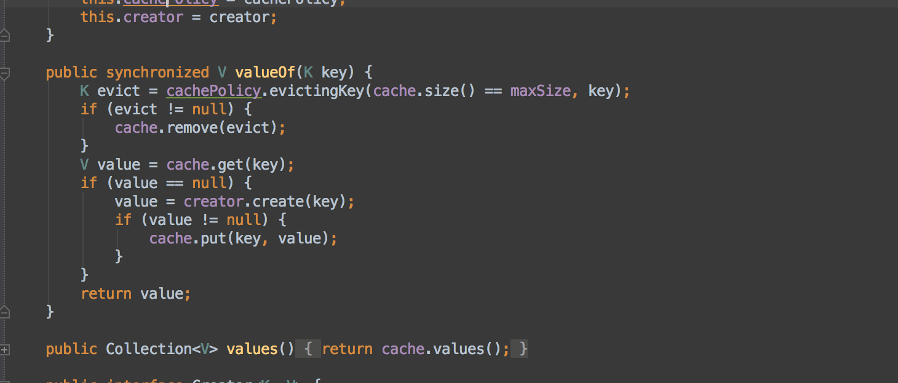


Functional Programming
LINQ
Advanced
C#
SoftUni Team
Technical Trainers
Software University
http://softuni.bg

Slide 2

Table of Contents
LINQ Queries
Simple Operations
Harder Operations
λ

Slide 3
Questions
sli.do #7153

Slide 4





LINQ to *
C#
VB.NET
Others …
.NET Language-Integrated Query (LINQ)
LINQ enabled data sources
LINQ enabled ADO.NET
LINQ to Objects
LINQ to DataSets
LINQ
to SQL
LINQ to
Entities
LINQ
to XML
<book>
<title/>
<author/>
<price/>
</book>
Objects
Relational Data
XML

Slide 5
LINQ: Simple Operations
Where()
Searches by given condition
First() / FirstOrDefault()
Gets the first matched element
Last() / LastOrDefault()
Gets the last matched element
Select()
Makes projection (conversion) to another type
OrderBy() / ThenBy() / OrderByDescending()
Orders a collection

Slide 6
LINQ: Simple Operations (2)
Any()
Checks if any element matches a condition
All()
Checks if all elements match a condition
Distinct()
Returns only the unique elements
Skip() / Take()
Skips or takes X number of elements

Slide 7
LINQ Examples
Using Select() to read an array in a single line:
Using Distinct() to get the unique elements from that array:
Using Where() to filter only the even numbers from the array:
Using OrderBy() to order them in ascending order:
int[] arr = Console.ReadLine().Split().Select(int.Parse).ToArray()
int[] uniqueArr = arr.Distinct().ToArray()
int[] evenNums = uniqueArr.Where(num => num % 2 == 0).ToArray()
int[] orderedArr = evenNums.OrderBy(num => num).ToArray()

Slide 8
LINQ Examples(2)
Using Any() to check if there is at least one even number:
Using All() to check if all numbers are odd:
Using First() to get the first even number:
Using LastOrDefault() to find the last odd number:
bool hasEven = arr.Any(num => num % 2 == 0)
bool hasOnlyOdd = arr.All(num => num % 2 == 1)
int firstEven = arr.First(num => num % 2 == 0)
int lastOdd = arr.LastOrDefault(num => num % 2 == 1)

Slide 9

LINQ: Harder Operations

Slide 10
GroupBy()
Transforms a collection into groups. Each group has a key.
In the example above we have List<> of IGrouping<K, V>. This is collection of values, which share the same key. We can iterate over the collection like that:
List<IGrouping<bool, int>> groups = arr.GroupBy(num => num % 2 == 0) .ToList()
foreach(var group in groups)
{
Console.WriteLine(“Is even: {0} - ”, group.Key);
Console.WriteLine(string.Join(“, ”, group));
}

Slide 11
ToDictionary()
Transforms a collection to dictionary
In this example we transformed the List<IGrouping<K, V>>
from the previous slide to Dictionary<K, List<V>>.
Dictionary<bool, List<int>> dict = arr.GroupBy(num => num % 2 == 0) .ToDictionary(g => g.Key, g => g.ToList());

Slide 12

GroupBy() and ToDictionary()
Exercises in class

Slide 13
SelectMany()
Collapses multiple collections to a single collection
Here we’ve combined all of the lists in the dictionary to a single array of integers.
Dictionary<bool, List<int>> dict = new Dictionary<bool, List<int>>()
int[] arr2 = dict.SelectMany(key => key.Value).ToArray()

Slide 14
Zip()
Operates over 2 collections in parallel
Here we added the values of the 2 arrays.
int[] arr = new int[] {1, 2, 3, 4, 5};
int[] arr2 = new int[] {5, 4, 3, 2, 1};
int[] result = arr.Zip(arr2, (a, b) => (a + b));

Slide 15
SelectMany() and Zip()
Exercises in class

Slide 16
Join() and GroupJoin()
Live Dem and Exercises in class

Slide 17








LINQ
https://softuni.bg/courses/advanced-csharp

Slide 18

License
This course (slides, examples, demos, videos, homework, etc.) is licensed under the "Creative Commons Attribution-NonCommercial-ShareAlike 4.0 International" license
Attribution: this work may contain portions from
"Fundamentals of Computer Programming with C#" book by Svetlin Nakov & Co. under CC-BY-SA license
"OOP" course by Telerik Academy under CC-BY-NC-SA license

Slide 19






Free Trainings @ Software University
Software University Foundation – softuni.org
Software University – High-Quality Education, Profession and Job for Software Developers
softuni.bg
Software University @ Facebook
facebook.com/SoftwareUniversity
Software University @ YouTube
youtube.com/SoftwareUniversity
Software University Forums – forum.softuni.bg

